Slide 1
PROJECT – SECOND REVIEW
Design and Implementation of AI Based Surveillance and Object Detection Robot
Presented By:
D.S.N.SAI VENKAT (19345A0411).
K. SIVA SAI (18341A0470).
M.MADHU (18341A0492).
K. NAVEEN KUMAR ( 18341A0480).
K.SIREESHA (18341A0478).
A.S.P.DHEERAJ (19345A0413).
Supervisor:
Dr. B. Anil Kumar
Sr. Assistant Professor
Dept. of ECE, GMRIT

Slide 2
OBJECTIVE OF THE PROJECT
To understand the Pros and Cons of present surveillance system by studying the latest research papers.
To capture the live video by interfacing Pi Camera .
To build the deep object detection model using algorithms to detect the objects of interest.
To design the surveillance Robot with Raspberry Pi.
To integrate the trained object detection and threat detection model using model with Raspberry Pi board.
To monitor the live video for surveillance using IOT concepts from remote location.

Slide 3
LITERATURE SURVEY
The existing video surveillance approaches from both academia and industry, to the best of our knowledge, offload the captured video to the cloud for further analysis. This precludes the initial analysis of videos to take place on-site, which leads to increased communication overhead and slows down security actions[1].
Lim et al. collected an annotated dataset consists of 5,500 gun images in various settings extracted from 250 recorded Closed Circuit Television Systems (CCTV) videos. [2]
Another crime detection system based on CCTV images was proposed in using deep learning models. When the system detects a potential crime, it sends an SMS message to the human supervisor to take the necessary actions [3].

Slide 4
LITERATURE SURVEY
Cont…
Grega et al proposed an algorithm for automatic firearms detection using recorded CCTV image analysis and situation recognition [4].
In the field of traffic monitoring, Zhang et al proposed a vehicle detection and annotation algorithm based on a fine-tuned CNN model [5].
The purpose of automating surveillance systems is to alleviate the burden on operators analyzing large amounts of data streams simultaneously [5].
Since digital cameras have proliferated across the world, numerous research perspectives have explored the development of automated surveillance systems[4].
Previous studies that have implemented automated surveillance systems considered application specific camera selection, improved hardware for real-time processing, as well as hardware and protocols for transmitting camera feeds to a central server.

Slide 5
GAP ANALYSIS AND OUTCOME OF LITERATURE SURVEY
The most of the existing video surveillance approaches work on either recorded videos or offload the video data into a centralized server in the cloud which is not appropriate for real-time threat detection.
Furthermore, none of the current video surveillance approaches can be deployed on the security camera due to its limited computational capabilities, which precludes taking advantage of minimizing the communication delays in such mission-critical security tasks.
Importantly, many previous works that detail the implementation of automated surveillance systems predate the wide adoption of CNNs.
Therefore, the considerations for developing a real-time surveillance system should be revised for these important systems.

Slide 6
GAP ANALYSIS AND OUTCOME OF LITERATURE SURVEY
Cont…
The specialized hardware and algorithm choices are important to ensure an effective implementation.
This work extends the body of knowledge by providing practical comparisons between YOLO-based algorithm that are useful for surveillance as well as the hardware processing units needed to run them.

Slide 7
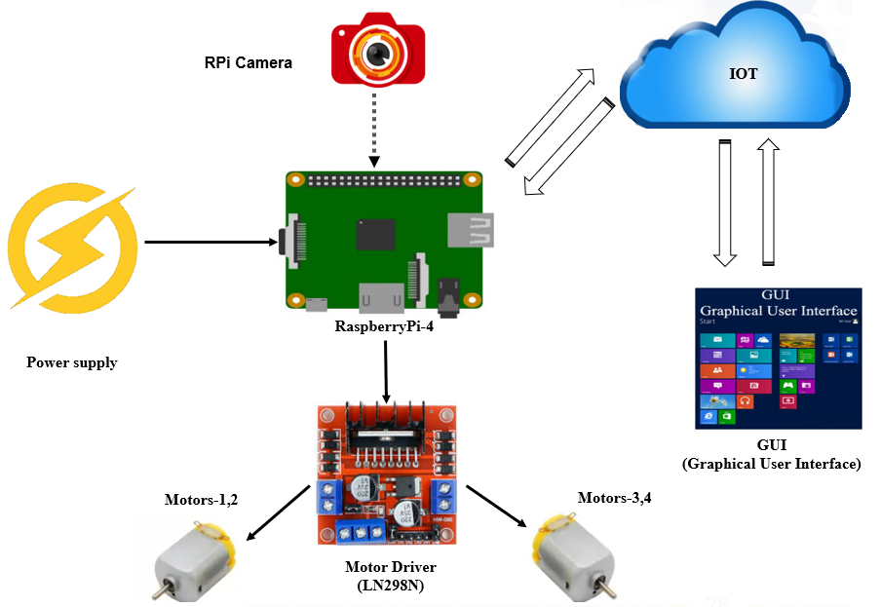
BLOCK DIAGRAM
Figure1: Block Diagram for surveillance vehicle.

Slide 8
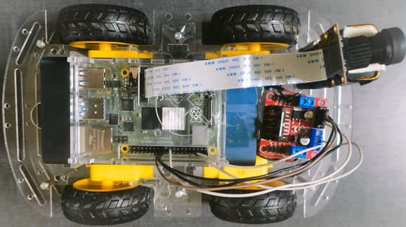
SURVEILLANCE SYSTEM
Motor Driver
L298N
Raspberry-Pi
4
Motor
NoIR
Pi Camera
Motor Driver Interfacing Pins
Flex Cable
Figure 2: Surveillance System.
Power Bank
Heat Sink

Slide 9
PROPOSED METHODOLOGY/ ALGORITHM
OBJECT DETECTION USING YOLO ALGORITHM
Object detection is basically the pinnacle feature of Artificial Intelligence. Object detection is a technique that uses Computer Vision and Image Processing to classify and locate specific objects in images or videos.
In order to detect objects, machine learning or deep learning algorithms are used.
For an instance Self Driving Cars use object detection technology where Computer Vision and Image Processing are used to determine the distance or area between the car and mobile object to alert and guide the car.
The fundamental principle in object detection is artificial intelligence. Data is collected using computer vision and fed into models that use Convolution Neural Networks (CNN), VGG or Residual Networks, and models are trained to detect objects in images and videos using Machine Learning or Deep Learning algorithms.

Slide 10
PROPOSED METHODOLOGY/ ALGORITHM Cont…
YOLO stands as an abbreviation for “You Only Look Once” was designed by Joseph Redmon and Ali Farhadi in the year 2016. Currently there are 6 versions of YOLO available for object detection.
YOLO uses CNN for detection of objects in images or videos (both live and recorded). YOLO is designed for the detection of multiple objects from a single image.
In order to that it can also predict the exact location of objects in the images. It has the most unique ability in detection of multiple classes (i.e., person, dogs, cats, watches etc) based on the datasets used during training.
YOLO uses single and distinctive neural network, the neural network divides images into grids and generates probabilities for each grid.
Following that, YOLO predicts the required number of bounding boxes and selects the best one based on the generated probabilities. Using the COCO dataset, it can detect 80 classes

Slide 11
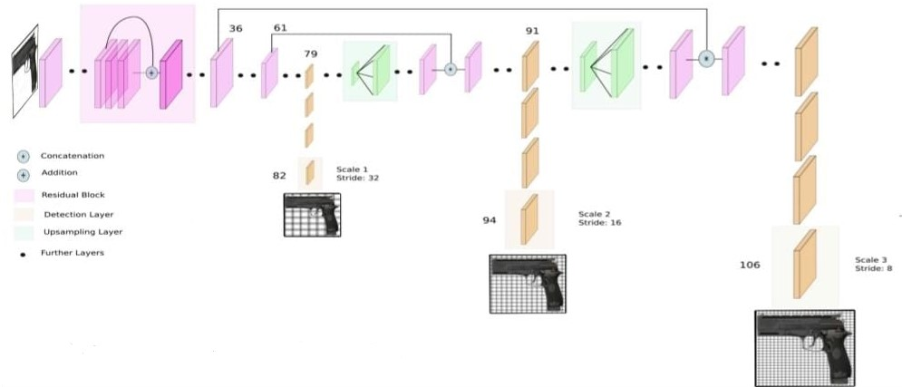
PROPOSED METHODOLOGY/ ALGORITHM Cont…
ARCHITECTURE Of YOLO V3
Figure 3. Architecture of YOLO V3

Slide 12
PROPOSED METHODOLOGY/ ALGORITHM Cont…
From the figure 1 YOLO V3 architecture is clearly evident that it uses CNNs. YOLO V3 is uses Darknet Framework called “DarkNet-53”. YOLO V3 uses 53 convolution neural network layers for detection tasks stacked with additional 53 more layers. So, a total of 106 layers for YOLO V3.
The Darknet framework loads all these 106 layers during the time of object detection. Even though there are 106 CNN layers only 3 layers primarily involve in object detection those layers include CNN layer-82, CNN layer-94, CNN layer-106. During the functioning of these layers the most important elements include
Residual Blocks and Skip Connections
Activation Function
IoU (Intersection Over Union)
Non-maximum suppression

Slide 13
PROPOSED METHODOLOGY/ ALGORITHM Cont…
YOLO V3 doesn’t use pooling layers such as max pooling or average pooling it only uses convolution layers.
3 | 10 | 23 | 16
9 | 4 | 7 | 2
11 | 9 | 19 | 18
1 | 2 | 17 | 25
Max Pooling
10 | 23
11 | 25
Stride-2
4 X 4
2 X 2
Figure 4. Max Pooling for the feature maps
3 | 10 | 23 | 16
9 | 4 | 7 | 2
11 | 9 | 19 | 18
1 | 2 | 17 | 25
1 | 1
1 | 1
Stride-2
29 | 45
23 | 79
4 X 4
2 X 2
2 X 2
Figure 5. Convolution for the feature maps

Slide 14
PROPOSED METHODOLOGY/ ALGORITHM Cont…
INPUT TO THE NETWORK
YOLO V3 detects objects on images, video (both live and recorded), so the input to the YOLO V3 network is batches of images. These batch of images are generally of the form (n , Wt , Ht , 3) where n represents the number of images, Wt represents width of image, Ht represents the height of image, 3 represents for number of channels (RGB -Red, Green, Yellow).
Height and Width can be changed but must be divisible by 32. The very Height and Width are sometimes considered to be input to the network. A few combinations for height and width are (416 X 416), (608 X 608), (832 X 832), (1024 X 1024).
With the increment of resolution of input images, model’s accuracy after training can be increased. Images can be of any size when fed to the network, there is no need to resize them as they will automatically get resized to the network.

Slide 15
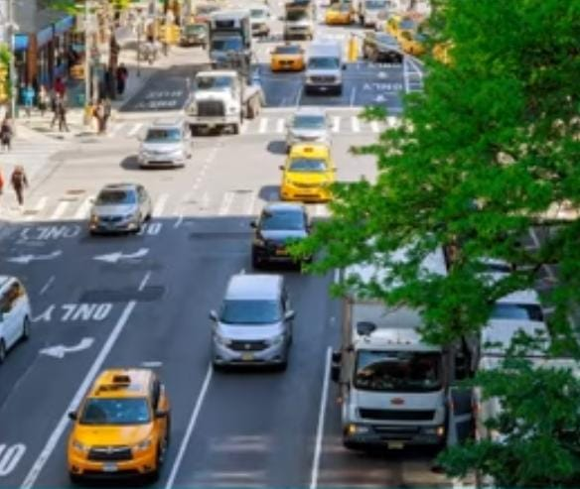


PROPOSED METHODOLOGY/ ALGORITHM Cont…
DETECTION AT 3 SCALES
416 X 416
Stride-32 Stride-16 Stride-8
Layer-82 Layer-94 Layer-106
13 X 13 26 X 26 52 X 52
Figure 6. Down-sampling of network image at 3 scales

Slide 16
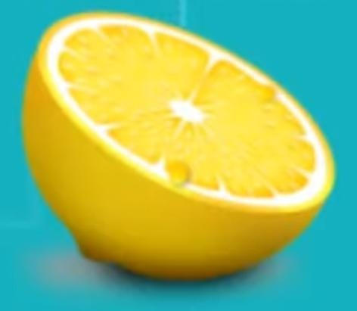
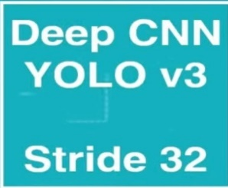
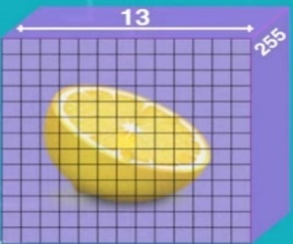
PROPOSED METHODOLOGY/ ALGORITHM Cont…
DETECTION KERNELS – GRID CELLS – ANCHOR BOXES
416 X 416
13 X 13
1
1
BB1
BB2
BB3
255
t_{x} | t_{y} | t_{w} | t_{h} | p₀ | p₁ | p₂ | p₃ | … | p_{c}
Figure 7. Attributes detection using anchors

Slide 17
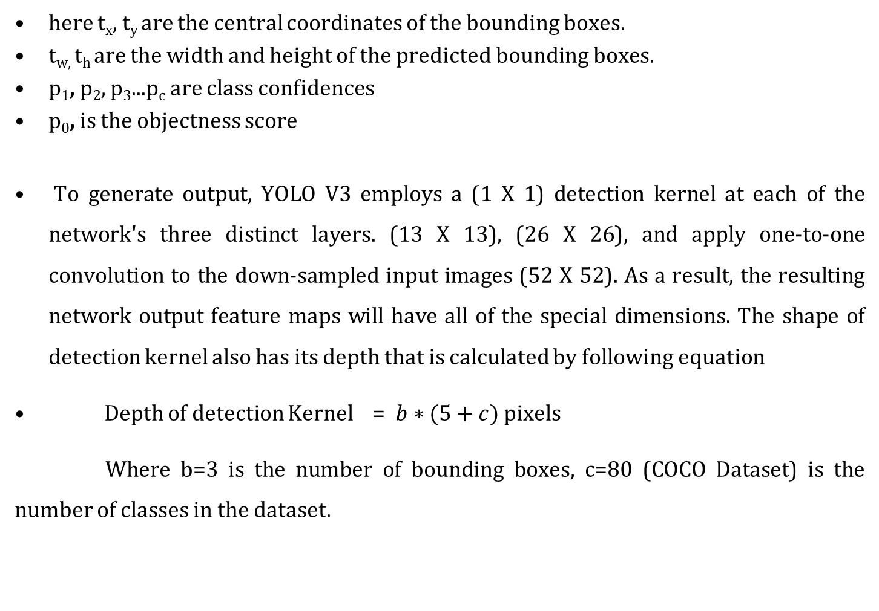
PROPOSED METHODOLOGY/ ALGORITHM Cont…
here t_{x}, t_{y} are the central coordinates of the bounding boxes.
t_{w,} t_{h} are the width and height of the predicted bounding boxes.
p₁, p₂, p₃...p_{c} are class confidences
p₀, is the objectness score
To generate output, YOLO V3 employs a (1 X 1) detection kernel at each of the network's three distinct layers. (13 X 13), (26 X 26), and apply one-to-one convolution to the down-sampled input images (52 X 52). As a result, the resulting network output feature maps will have all of the special dimensions. The shape of detection kernel also has its depth that is calculated by following equation
Depth of detection Kernel = $b∗(5+c)$ pixels
Where b=3 is the number of bounding boxes, c=80 (COCO Dataset) is the number of classes in the dataset.

Slide 18
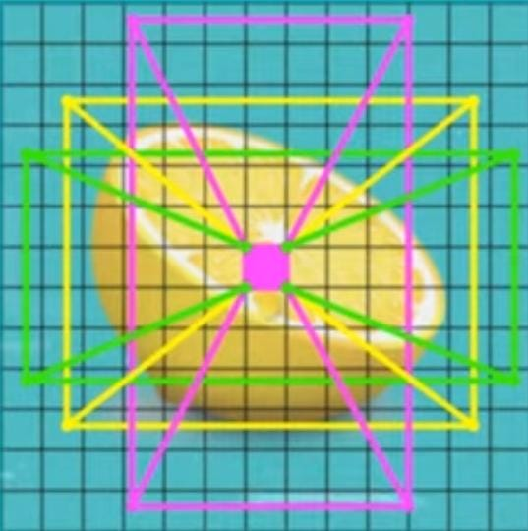
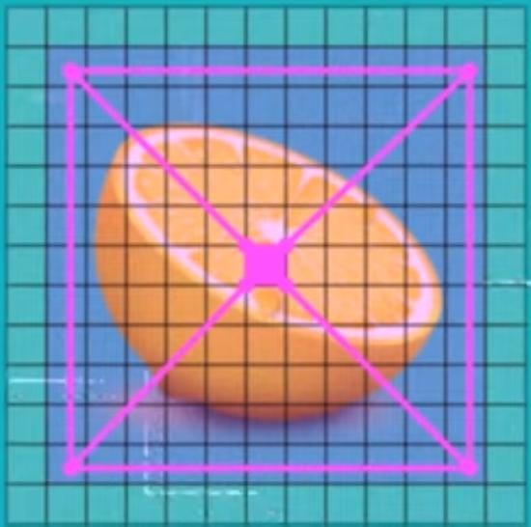
PROPOSED METHODOLOGY/ ALGORITHM Cont…
Since we have used COCO dataset there are 80 classes and 255 attributes. Now we must extract the probabilities among the three predicted bounding boxes of the cell in order to determine whether or not this box contains a specific class.
To do so, we compute the element-wise product of the objectness score and the list of confidences, then find the maximum probabilities and can say with certainty that this box detected a specific class.
Figure 8. Centre cell prediction
Figure 9. Centre cell prediction for ground truth bounding box

Slide 19
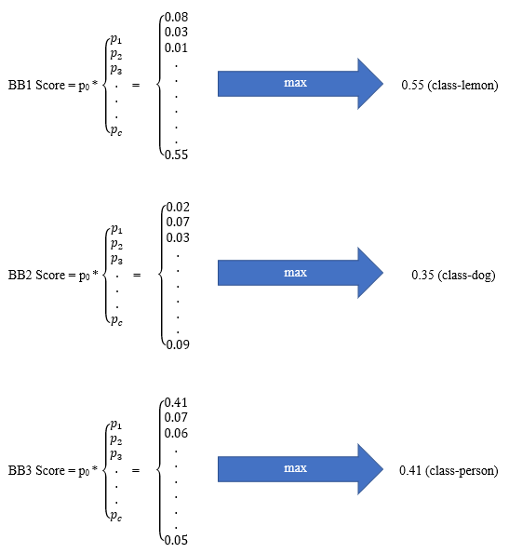
PROPOSED METHODOLOGY/ ALGORITHM Cont…

Slide 20
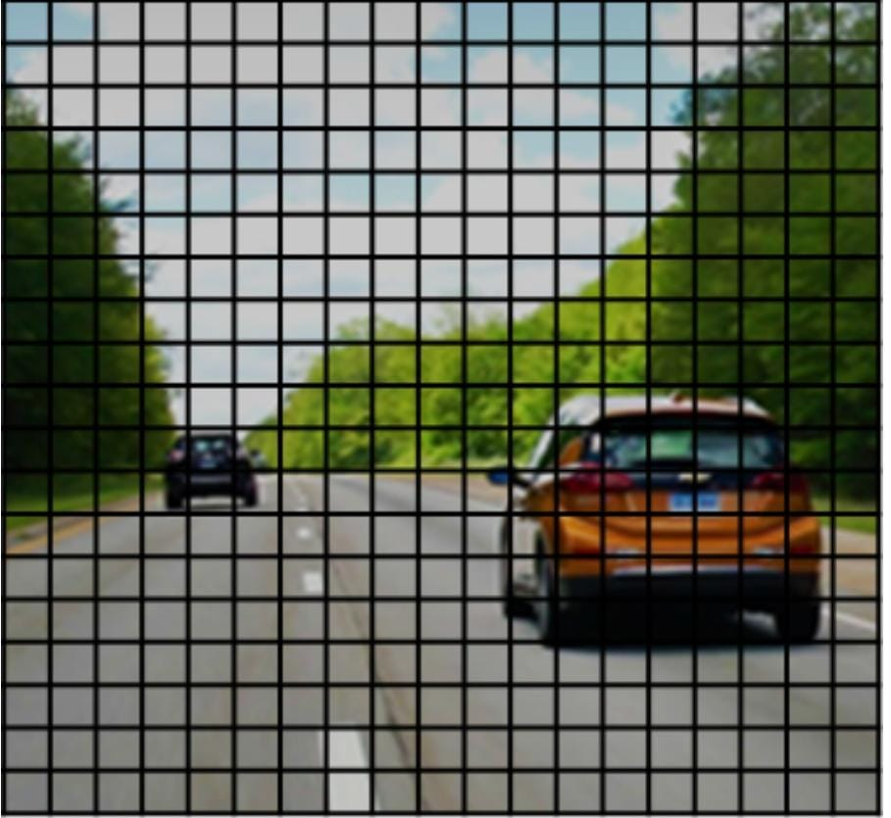
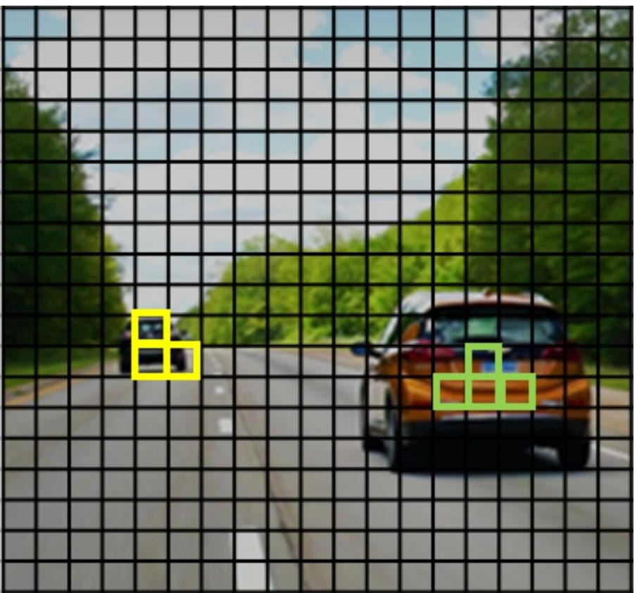
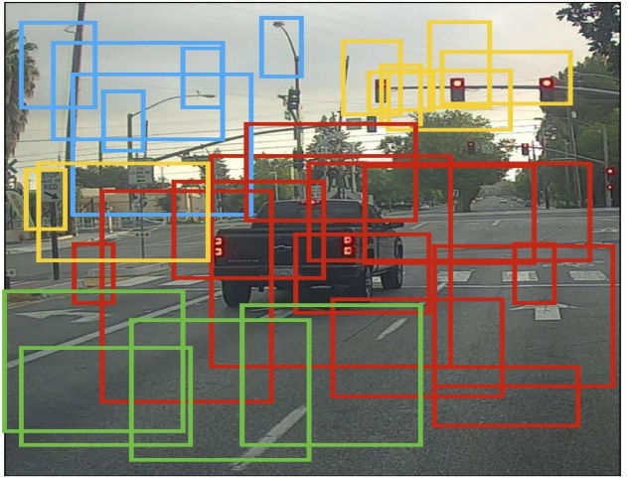
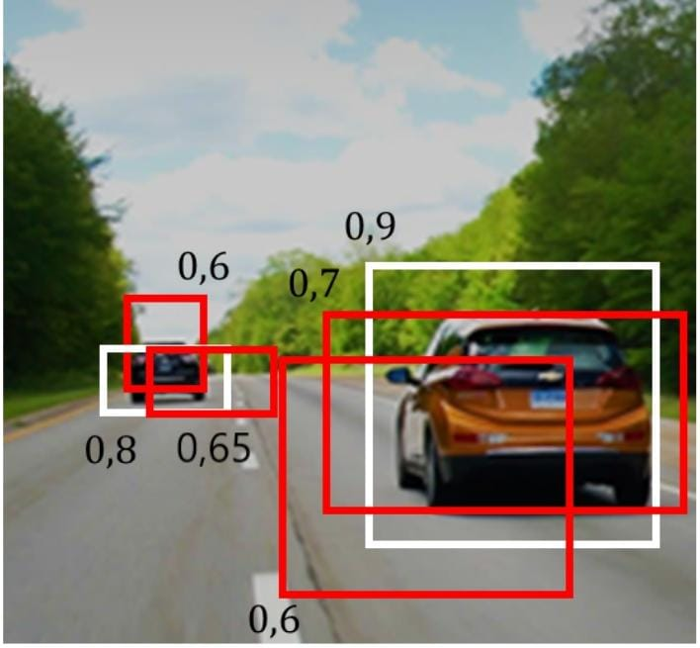
PROPOSED METHODOLOGY/ ALGORITHM
Cont…
Figure 9.Grid (19X19) that YOLO builds
Figure 10.Each of these two cars has one midpoint so it should be assigned to grid cells
Figure 11. Bounding box Formation
Figure 12. Multiple Confidence levels

Slide 21
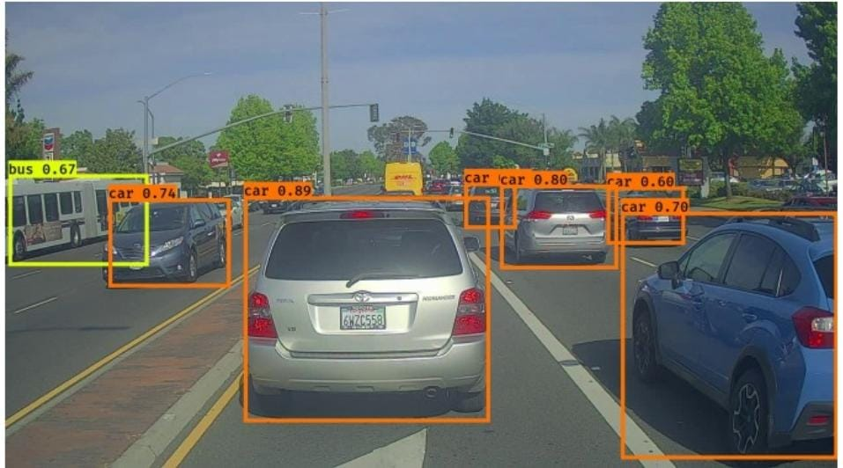
PROPOSED METHODOLOGY/ ALGORITHM
Cont…
Figure 13.Each bounding box is predicted with a confidence level. You can see the confidence scores in the top-left corner of each box, next to the object name.

Slide 22
PROPOSED METHODOLOGY/ ALGORITHM
Cont…
Flow Chart for Weapon Detection
Start
Camera Input Data
Process live Video
Key Frame Extraction
No
Image Recognition
Is it a Weapon?
Yes
Alert Notification
End

Slide 23
PROPOSED METHODOLOGY/ ALGORITHM
Cont…
Threat Detection System using YOLO
Every year, a large amount of population reconciles gun-related violence all over the world. In this work, we develop a computer-based fully automated system to identify basic armaments, particularly handguns and rifles.
Recent work in the field of deep learning and transfer learning has demonstrated significant progress in the areas of object detection and recognition. We have implemented YOLO V3 “You Only Look Once” object detection model by training it on our customized dataset.
The training results confirm that YOLO V3 outperforms YOLO V2 and traditional convolutional neural network (CNN). Additionally, intensive GPUs or high computation resources were not required in our approach as we used transfer learning for training our model.

Slide 24
PROPOSED METHODOLOGY/ ALGORITHM Cont…
Applying this model in our surveillance system, we can attempt to save human life and accomplish reduction in the rate of manslaughter or mass killing. Additionally, our proposed system can also be implemented in high-end surveillance and security robots to detect a weapon or unsafe assets to avoid any kind of assault or risk to human life.

Slide 25
PROPOSED METHODOLOGY/ ALGORITHM
Cont…
The base model for weapon detection system is operated using python where the primary importing packages are OpenCV and numpy.
The classes that are used in this model are solely weapons such as guns, knives, swords etc.
This model is coded in python and is tested on pycharm IDE. We install the same packages and IDE on Raspberry pi.
So this base model was trained using UGR(UNIVERSIDAD DEGRANADA) hand guns and the IMFDB(Internet Movie Firearm Database) .For testing gun detection, we are using the UGR handgun testing dataset and the IMFDB dataset . The IMFDB dataset contains around 1500 images of various guns, rifles, shotguns, etc. These are images of various movie scenes. The negative images in the dataset contain images of objects with shapes similar to a gun like hairdryers, drills, etc.

Slide 26
PROPOSED METHODOLOGY/ ALGORITHM
Cont…
IOT makes it easy to manage access to services and devices in the cloud and in the field.
IOT grant anyone access to devices, services, and networks with a simple, one-time invitation.
Access your desktop anytime, from anywhere and any device. Fast, secure, and affordable. Remote desktop software for your computers and mobile devices.
Access to an organizational information system by a user (or an information system) communicating through an external, non-organization-controlled network
We implemented our intelligent surveillance vehicle to access it from anywhere from the world.

Slide 27
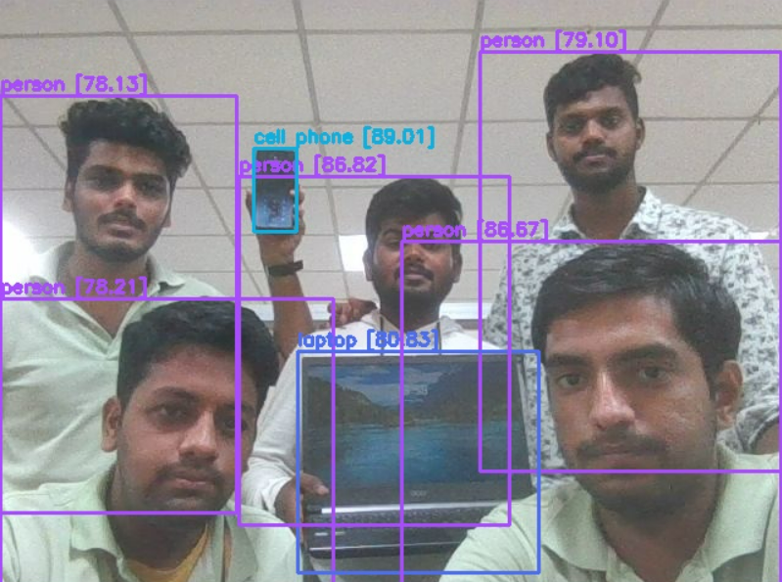
RESULTS AND DISCUSSION
Figure 14: Final object detection system using YOLO V3.

Slide 28
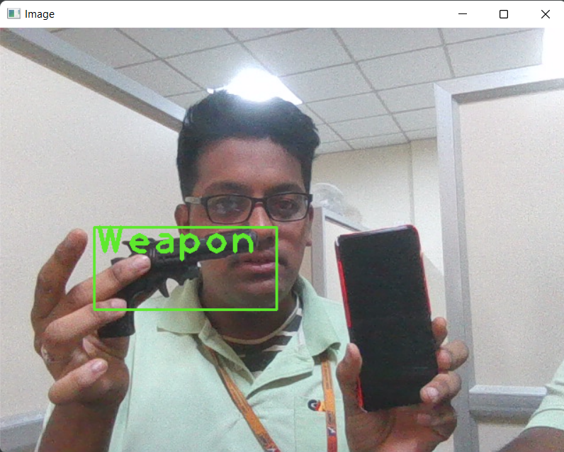
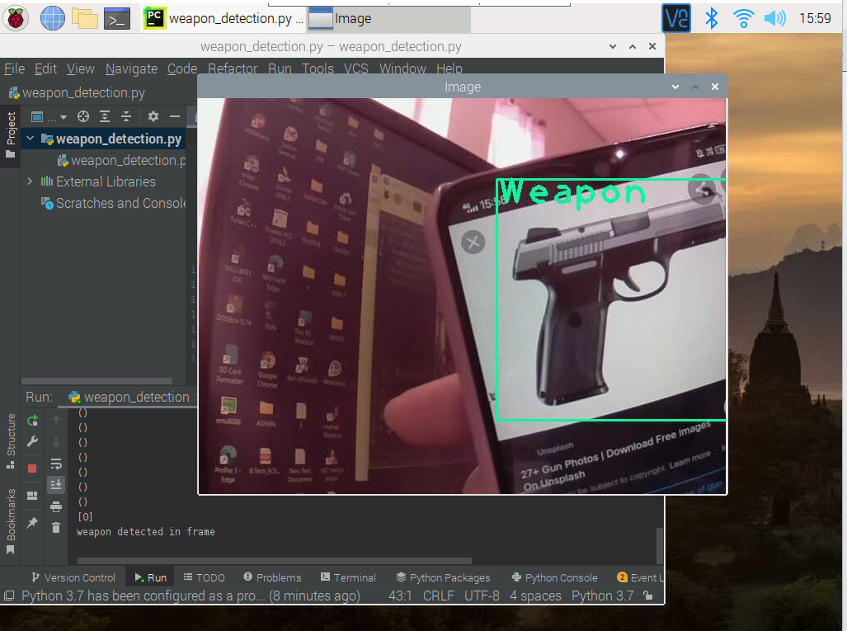
RESULTS AND DISCUSSION
Figure 15: Physical gun detected in the frame and being alerted.
Figure 16: Gun detected in the frame as weapon and being alerted.

Slide 29
RESULTS AND DISCUSSION
Model performance parameters on different datasets
Parameter | UGR | IMFDB | COCO
Accuracy | 0.8567 | 0.8174 | 0.8864
Precision | 0.8396 | 0.7891 | 0.8234
F1 Score | 0.8957 | 0.8221 | 0.8456
Recall | 0.9563 | 0.8536 | 0.9345
Accuracy = (TP + TN) / (P + N)
Precision = TP / (TP + FP)
Recall = TP / (TP + FN)
F1 Score= 2*(Precision* Recall)/(Precision + Recall)
TP- True Positive
TN- True Negative
FP- False Positive
FN- False Negative

Slide 30
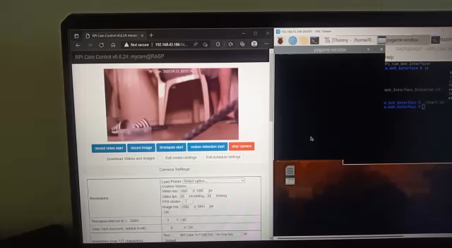
RESULTS AND DISCUSSION

Slide 31
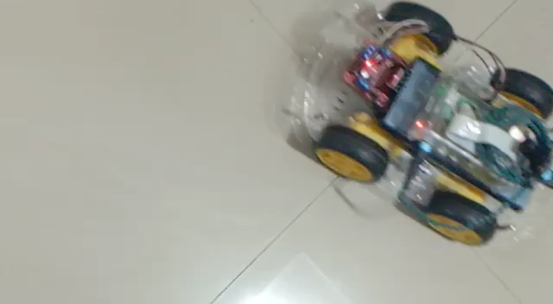
RESULTS AND DISCUSSION

Slide 32
FUTURE SCOPE
The same technology can be imbibed into a drone to make surveillance system more dynamic.
Taking more dataset images and training them and classifying into hazardous and non hazardous items.
We can include images of fire and water and train the datasets to detect hazards caused by fire, and the application of water to fire.
Addition of servo motors to the camera make the motion of camera much effective.
Using OV5647 MIPI(Mobile Industry Processor Interface) cameras yields better results in object detection in the dark.

Slide 33
References
[1]A. A. Moamen and N. Jamali, ‘‘Opportunistic sharing of continuous mobile
sensing data for energy and power conservation,’’ IEEE Trans. Services Comput.,
vol. 13, no. 3, pp. 503–514, May/Jun. 2020, doi: 10.1109/TSC.2017.2705685.
[2]J. Lim, M. I. Al Jobayer, V. M. Baskaran, J. M. Lim, K. Wong, and J. See, ‘‘Gun
detection in surveillance videos using deep neural networks,’’ in Proc. Asia–Pacific
Signal Inf. Process. Assoc. Annu. Summit Conf. (APSIPAASC), Nov. 2019, pp. 1998
2002.
[3]U. V. Navalgund and P. K., ‘‘Crime intention detection system using deep
learning,’’ in Proc. Int. Conf. Circuits Syst. Digit. Enterprise Technol. (ICCSDET), Dec.
2018, pp.1–6.

Slide 34
References
[4]M. Grega, S. Lach, and R. Sieradzki, ‘‘Automated recognition of firearms in
surveillance video,’’ in Proc. IEEE Int. Multi-Disciplinary Conf. Cog- nit. Methods
Situation Awareness Decis. Support (CogSIMA), Feb. 2013, pp. 45–50.
[5]Y. Zhou, L. Liu, L. Shao, and M. Mellor, ‘‘Fast automatic vehicle annotation for
urban traffic surveillance,’’ IEEE Trans. Intell. Transp. Syst., vol. 19, no. 6, pp. 1973
1984, Jun. 2018.
[6] Source of YOLO : https://pjreddie.com/darknet/yolo/
[7] Dataset Link for Yolo Object detection : https://cocodataset.org/#download
[8] Dataset : https://www.kaggle.com/datasets/atulyakumar98/fire-and-gun-dataset

Slide 35
References
[9]Configuration File : https://github.com/Manish8798/Weapon-Detection-with-yolov3/blob/master/weapon_detection/yolov3_testing.cfg
[10]Yolo Weight file : https://drive.google.com/file/d/10uJEsUpQI3EmD98iwrwzbD4e19Ps-LHZ/view?usp=sharing

Slide 36
THANK YOU

